Slide 1

Creativity
How creativity might lead us to increased well being or even flourishing. ????

Slide 2
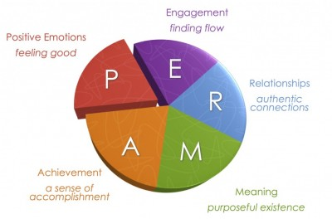
PERMA model

Slide 3
Csikszentmihalyi’s, (1999) work on flow was initially designed as part of studying the creative process.
Mindfulness research conducted by Langer, (2005) shows that being mindful also leads to enhanced creativity.
The process of accommodating oneself to the present moment leads to greater awareness and focus which in turn lets the creative juices flow.

Slide 4
Creativity is one of the character strengths, along with curiosity, judgment, love of learning and perspective, which define the virtue of wisdom and knowledge.
All of these are cognitive strengths which entail acquiring and applying knowledge.

Slide 5
Creativity requires a certain state of mind.
Research from the University of Western Ontario (Nadler et al, 2010) showed that participants who listened to happy music or viewed funny clips were more likely to think innovatively and solve the problem at hand than those who were not exposed.
These findings suggest that we first need to create a positive environment which will be beneficial to creativity in order to see an increase in our flow of ideas and innovation.

Slide 6
Three mechanisms play a role in creativity:
Authentic Self
Positive focus
Flow

Slide 7
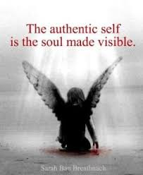
The Authentic Self:
Those individuals who count creativity amongst their signature strengths derive a sense of authenticity, purpose and meaning from exercising this strength, and finding ways of bringing as much creativity as possible into their lives.

Slide 8
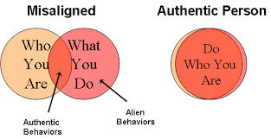
What shape or form this creativity depends on our personal “brand” of creativity, it may be artistic, cultural, inventive, scientific or basically any other kind of original activity.
If creativity is one of your character strengths, make sure you find ways to regularly exercise your creative muscles.

Slide 9

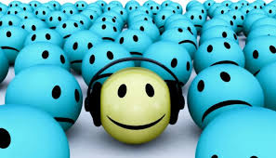
Positive focus:
Czikszentmihaly’s book “Creativity” is based on interviews with creative individuals from many walks of life and from varied careers.
Finding the time to incorporate creative activities into your life can open your mind to new discoveries, which can lead you to new places and ways to engage with the world.
Creativity when connected be beneficial for your well being, even if creativity is not necessarily one of your signature strengths.

Slide 10

Flow:
When challenges closely match a
person’s abilities they can enter
a state of flow.
Flow is the feeling of complete
Immersion and loss of sense of time when merging
actions with awareness.
This is experienced by individuals across a range of activities from artistic pursuits, to sports, music, science or invention.
Flow leads us to perceive an activity as enjoyable.

